Slide 1
Ginnie Mae Prepayment: Default
August 2016

Slide 2
Model Update Overview 1. Streamline Model Parameters
Default model V1
Changes
2
1. Add plausible long-range forecast : Months Since Starting Payment Status
Sub-models
For each starting payment status (current/delinq),we build a curve to show how default rates evolve over time.
Model for current loans
Model for delinquent loans
2. Add pct FHA parameter
5
With the FHA % goes up, the default rate of a ginnie mae pool increases.
Parameters
3. Add Credit Availability parameter
Incentive
CLTV
FICO
WALA
Pct delinquency
When there is more credit availability (CA), it tends to be easier for borrowers to refinance instead of default. Regression results support a negative correlation between CA and the default rate.
4. Remove adjustment functions
2
The old model involved tweaks because we used loan level data to calibrate the model and then used these adjustment factors to fit pool level data
Adjustment Functions
Decay function for CLTV, WALA, and incentive
5. Add constraints for extrapolation
Using cap and floors for out of range extrapolation. Make sure the tail performance is reasonable.

Slide 3
Model Update Overview 1. Streamline Model Parameters
Default model v1
Default model v2
2
2
Sub-models
Sub-models
Model for current loans
Model for delinquent loans
CDR = Current% * Model_CurrentLoans
+ Delinq% * Model_DelqLoans
5
8
Parameters
Parameters
Incentive
CLTV
FICO
WALA
Pct delinquency
MonthSinceStartingPaymentStatus
Pct Delinquency
Incentive
WALA
CLTV
Pct FHA
FICO
Credit Availability
2
Adjustment Functions
1
Tweaks for CLTV, WALA
Decay function for CLTV, WALA
Constraint
Constraints for extrapolation

Slide 4
Performance Comparison 1. Overall
Model Tracking Performance
Model v2 has better performance in two areas:
Overall, the v2 model fits closer to the actual default data. Lower the RMSE from 1.72 to 1.13.(by 34%)
For the most recent months, model v1 is too fast, while v2 has better tracking

Slide 5
v3 Default Model Details 1. Model Multipliers
01
Month since current / delinq status helps to predict the long term evolution of pool default rates
v2 of the default model includes the five prediction parameters listed on the left-hand side.
Sequentially fitting model with the five parameters, we can create a cubic spline curve for each one of these inputs.
The parameter ordering is based on a single parameter regression calculated R-square value.
Parameters that have earlier order will have more significant impact on our model out put.
Month Since Start
02
Borrower with higher incentive normally has better profile and lower risk of default.
Incentive
03
The WALA ramp effect shows a increasing trend of default as loan age goes up.
WALA
04
Borrower with higher CLTVs will have a higher risk of default.
CLTV
05
With the FHA% increases in the pool, the default probability goes up at the same time.
Pct FHA
06
Borrowers with lower FICO scores have higher risk of default. But the FICO record for GNMA loans are not quite complete.
FICO
07
When credit availability goes higher, borrowers will have a better chance to refinance lowers the default rate.
Credit Availability

Slide 6
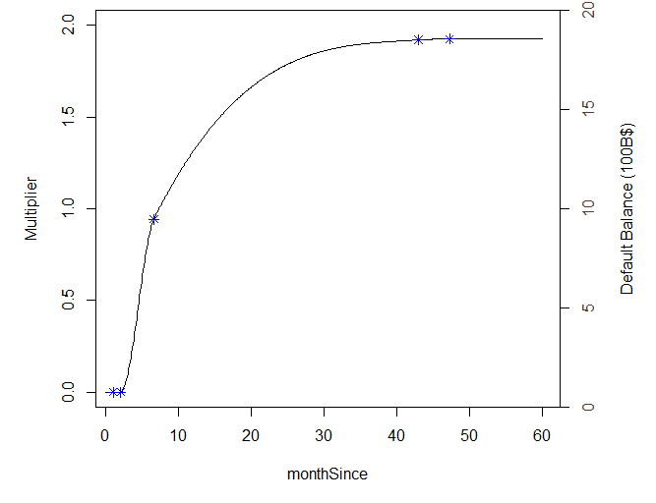
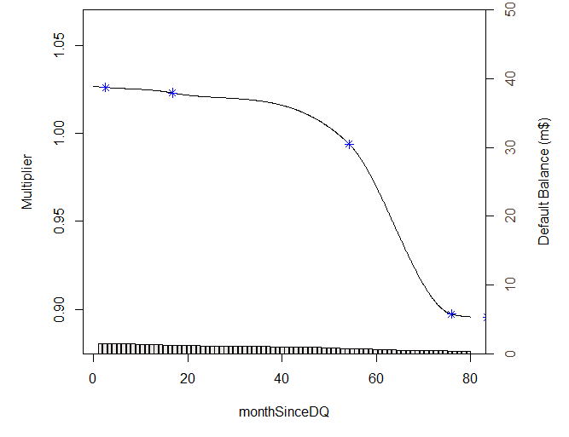
v3 Default Model Details 2. Model Multiplier Splines – Baseline Curves
For the loans that are currently delinquent/current, we have two separate baseline curves that describe the longer term of their default performance going forward.
The curves are a function of the Month Since Starting Payment Status. Meaning if the loan is currently at “current” status, its default rate will follow the left-hand-side chart starting from that month. Or it will follow the RHS curve is it is currently at “delinquent” status.
On pool level, the LHS curve stands for pools with 100% current underling loans; and the RHS stands for 100% delinquent.
Month Since Current
Month Since Delinquent
Baseline Constant:
CPR: 0.056
Baseline Constant:
CPR: 48.45

Slide 7
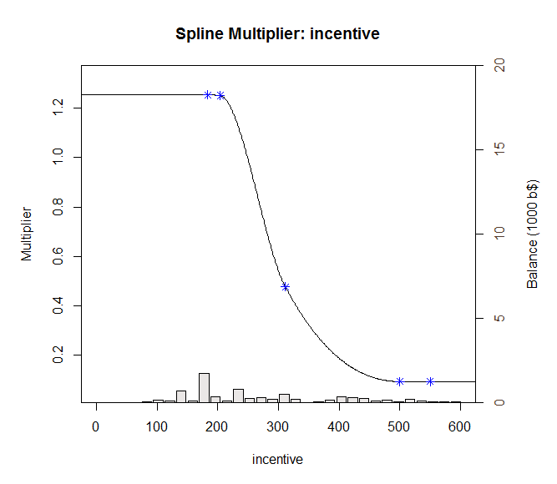
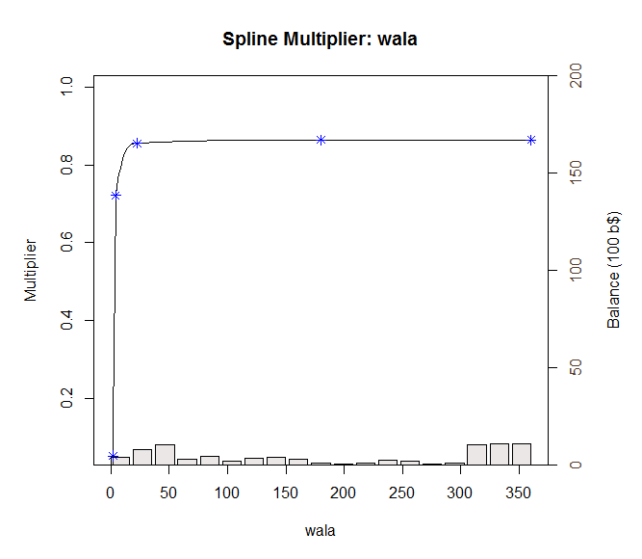
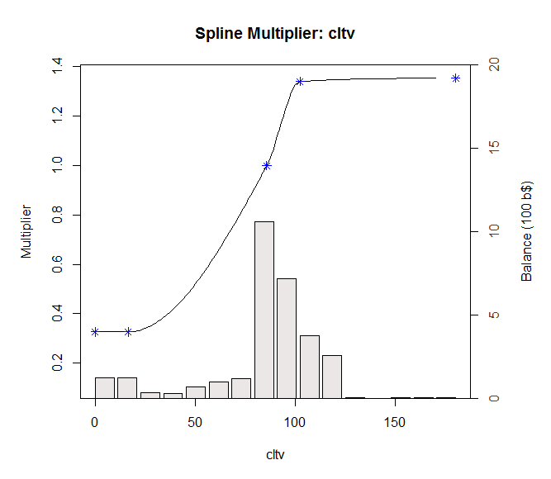
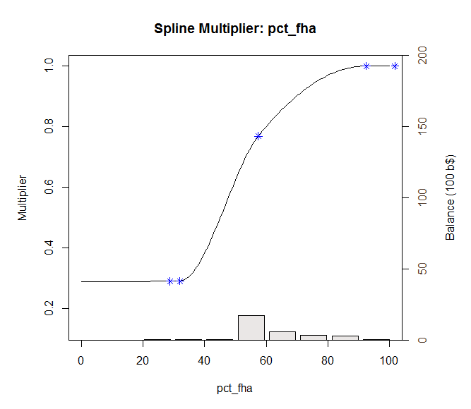
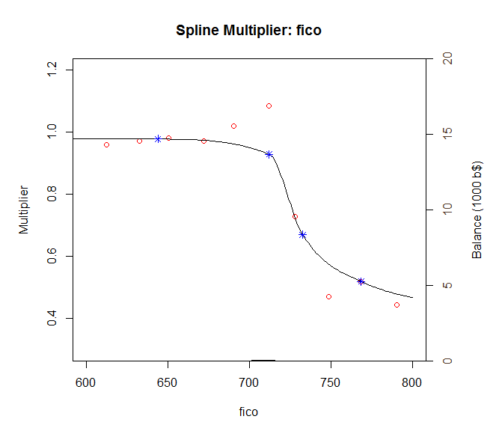
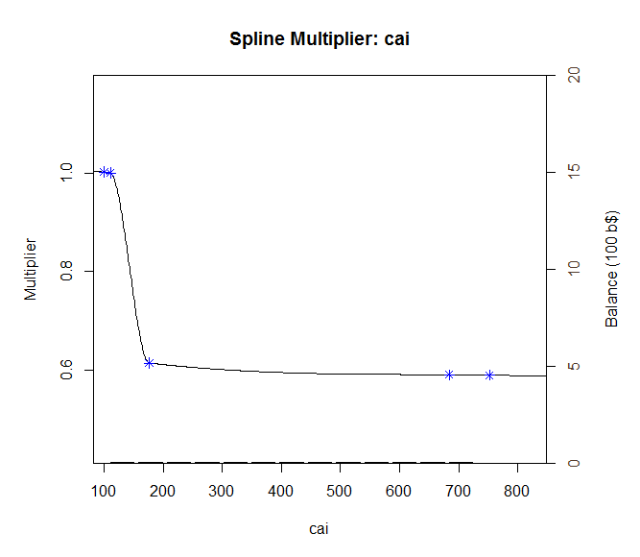
v3 Default Model Details 2. Model Multiplier Splines - Delinquent

Slide 8
Appendix 1. Max Value of Multipliers
100% Delinquent Pools
 | Min | Max
baselineConstant | 48.45 | 48.45
Incentive | 0.73 | 1.11
wala | 0.00 | 0.98
cltv | 0.15 | 1.25
fico | 0.44 | 0.98
pct_fha | 0.64 | 1.05
Credit availability | 0.59 | 1.17
Default (%CPR) | 0.000 | 79.31

